Slide 1
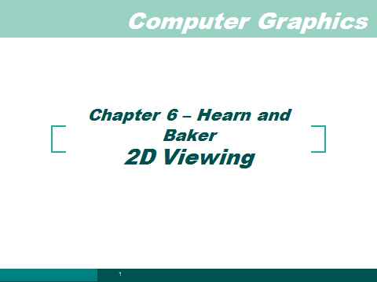

Slide 2
Transformation
P(x, y, z)
3D Object Coordinates
Modeling
Transformation
3D World Coordinates
Viewing
Transformation
3D Viewing Coordinates
Projection
Transformation
2D Projection Coordinates
Window-to-Viewport
Transformation
2D Device Coordinates
P(x, y)

Slide 3
2D Rendering Pipeline
2D Primitives
Clipping
Clip portions of geometric primitives
residing outside window
Viewport Transformation
Transform the clipped primitives
from screen to image coordinates
Scan Conversion
Fill pixel representing primitives
in screen coordinates
Image

Slide 4
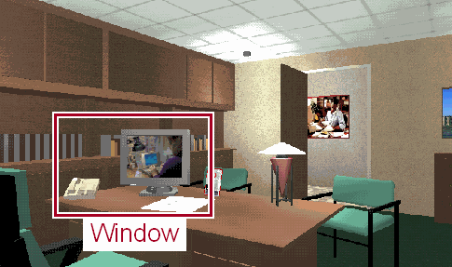
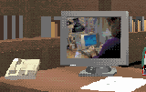
Viewport Transformation
Transform 2D Geometric Primitives from Screen Coordinate System (Projection Coordinates) to Image Coordinate System (Device Coordinates)
Screen
Image
Viewport

Slide 5
Window vs. Viewport
Window
  World-coordinate area selected for display
  What is to be viewed
Viewport
  Area on the display device to which a window is mapped
  Where it is to be displayed

Slide 6
Viewport Transformation
Window-to-Viewport Mapping
Window
Viewport
wy2
vy2
(wx, wy)
(vx, vy)
wy1
vy1
wx1
wx2
vx1
vx2
Screen Coordinates
Image Coordinates
vx = vx1 + (wx – wx1) * (vx2 – vx1) / (wx2 – wx1);
vy = vy1 + (wy – wy1) * (vy2 – vy1) / (wy2 – wy1);

Slide 7
Try this
Convert Window( 0,2.0,0,1.0) =W(l,r,b,t)to V(40, 400, 60, 300) = v( l,r,b,t)
Sx= Ax +C
Sy= By+D
A= (v.r – v.l) / (w.r-w.l) , C= v.l – A w.l
B= (v.t – v.b) / (w.t-w.b), D= v.b – B w.b

Slide 8
Soln
A = 180, C= 40, B=240, D=60
Sx= 180x + 40;
Sy=240y+60;

Slide 9
Open GL Implementation
In 2D , world window is set by
gluOrtho2D (0.0, winWidth, 0.0, winHeight); //sets the window to lower left corner (left,bottom)= (0,0) to upper right corner(right,top) = (W,H)
More general case :
void gluOrtho2D (GLdouble left, GLdouble right, GLdouble bottom, GLdouble top);

Slide 10
Open GL Implementation
In 2D , viewport is set by
void glViewport (GLint x, GLinty, GLint width, GLint Height ); //sets the window to lower left corner (x,y)= (0,0) default to upper right corner(right,top) = (x+W, y+H)

Slide 11
OpenGL
In the above problem, we can define
void init(void)
{ glMatrixMode (GL_PROJECTION);
gluOrtho2D (0.0, 2.0, 0.0, 1.0);
glViewport(40, 60,360, 240);
}
If you remove the glViewport, then OpenGL cosiders the default view port set by the window size in main( ) as
glutInitWindowSize( W, H )

Slide 12
User Defined
void setwindow(float left,float right, float bottom, float top )
{
glMatrixMode (GL_PROJECTION);
glLoadIdentity( );
gluOrtho2D (left, right, bottom, top);
}

Slide 13
User Defined
void setViewport (int left,int right, int bottom, int top )
{
glViewport(left, bottom, right-left, top-bottom);
}

Slide 14
2D Rendering Pipeline
3D Primitives
2D Primitives
Clipping
Clip portions of geometric primitives
residing outside window
Viewport Transformation
Transform the clipped primitives
from screen to image coordinates
Scan Conversion
Fill pixel representing primitives
in screen coordinates
Image

